Slide 1

Speeding Up Online Training of L1 Support Vector Machines
Gabriella Melki
Ph.D. Student,
melkiga@vcu.edu
Vojislav Kecman
Professor,
vkecman@vcu.edu
Notes:
General introduction
Who we are
What this is about
SGD procedure for solving SVM problem
Experimental setup for testing the performance of SGD

Slide 2

Agenda
Motivation
Some Issues
Classifiers and Risks
Stochastic Gradient Descent Procedure
Kernelized Classifiers
Issues Covered
Problem Description
Regularized Hinge Loss Problem
Kernelized Soft-SVM Problem
Non-Linear SGD for SVM
Experimental Environment
Results
Comparison Between NL-SGD, MN-SVM and NN-ISDA
Accuracies Of The Different Configurations of NL-SGD
CPU Training Times Of The Different Configurations of NL-SGD
Conclusion

Slide 3
Motivation
Data sizes have grown disproportionately to the speed of processors and memory sizes
Stochastic algorithms are being investigated to optimize large scale learning problems
Support Vector Machines (SVMs) have been shown to outperform other learning algorithms in terms of
computational complexity
scalability
robustness against outliers
most importantly, they are well suited for large datasets

Slide 4

Issues
Classifiers and Risks
Use the bias term b, or not
Use a regularizer, if so, which one
Stochastic Gradient Descent (SGD)
Cyclical updates or worst violator
How many epochs should be used
Calculating final weight or $α$ vector
Averaging over all iterations
Averaging over the last 25% or 50% iterations
Last vector
Choosing the learning rate
η = 1/t or
η = 2/√t
Others
Newton-Raphson instead of SGD
Kernelized Classifiers
Which kernel function should be use
Gaussian
Polynomial
Others
SVM Hyper-parameter values
Penalty parameter C
Gaussian shape parameter σ
Polynomial order
Others

Slide 5

Issues Covered by this Experiment
Classifiers and Risks
Use the bias term b, or not
Use a regularizer, if so, which one
Stochastic Gradient Descent (SGD)
Cyclical updates or worst violator
How many epochs should be used
Calculating final weight or $α$ vector
Averaging over all iterations
Averaging over the last 25% or 50% iterations
Last vector
Choosing the learning rate
η = 1/t
η = 2/√t
Others
Newton-Raphson instead of SGD
Kernelized Classifiers
Which kernel function should be use
Gaussian
Polynomial
Others
SVM Hyper-parameter values
Penalty parameter C
Gaussian shape parameter σ
Polynomial order
Others

Slide 6
Agenda
Motivation
Some Issues
Classifiers and Risks
Stochastic Gradient Descent Procedure
Kernelized Classifiers
Issues Covered by this Experiment
Problem Description
Regularized Hinge Loss Problem
Kernelized Soft-SVM Problem
Non-Linear SGD for SVM
Experimental Environment
Results
Comparison Between NL-SGD, MN-SVM and NN-ISDA
Accuracies Of The Different Configurations of NL-SGD
CPU Training Times Of The Different Configurations of NL-SGD
Conclusion

Slide 7


Problem Description
Regularized Hinge Loss
$λ$ is the regularization parameter
The regularizer, ${\left\|w\right\|}^{2}$, is the L2 norm of $w$
$L_{hl}\left(w\right)$ is the hinge loss function $\frac{1}{m}\sum_{i=1}^{m}{max⁡\{0, 1−y_{i}〈w,xi 〉\}}$, where $m$ is the number of samples in dataset $D, \left(x_{i},y_{i}\right)∈D, ∀i=1,…, m$
Kernelized Soft-Margin SVM
$$\min_{w}{R_{rhl}\left(w\right)=\left(\frac{λ}{2}{\left\|w\right\|}^{2}+\frac{1}{m}\sum_{i=1}^{m}{max⁡\{0, 1−y_{i}〈w, ψ\left(x_{i}\right)〉\}}\right)}$$
$ψ\left(x_{i}\right)$ is the mapping function for the input vector $x_{i}$ to a higher dimension
$$\min_{w} R_{rhl}\left(w\right)=\left(\frac{λ}{2}{\left\|w\right\|}^{2}+ L_{hl}\left(w\right)\right)$$

Slide 8
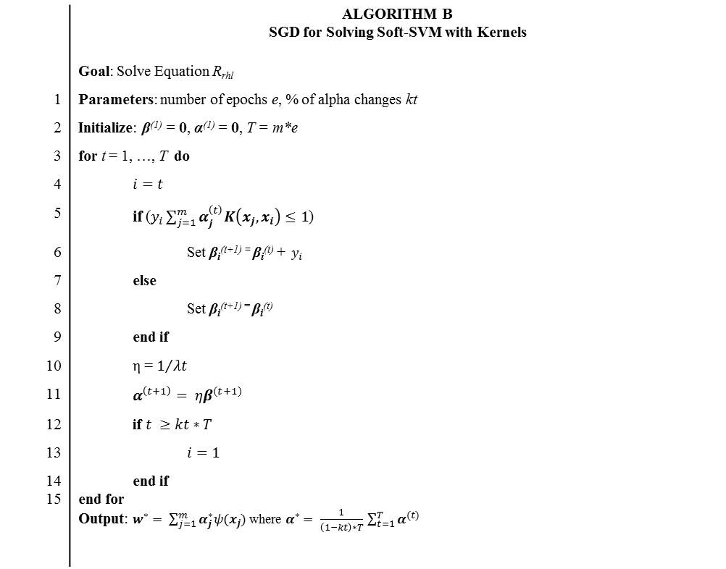
Non-Linear SGD for SVM
 | ALGORITHM B SGD for Solving Soft-SVM with Kernels
 | Goal: Solve Equation R_{rhl}
1 | Parameters: number of epochs e, % of alpha changes kt
2 | Initialize: β⁽¹⁾ = 0, α⁽¹⁾ = 0, T = m*e
3 | for t = 1, …, T do
4 | $$i=t$$
5 | if ($y_{i}\sum_{j=1}^{m}{α_{j}^{\left(t\right)}K\left(x_{j},x_{i}\right)≤1}$)
6 | Set β_{i}^{(t+1) =} β_{i}^{(t)} +${ y}_{i}$
7 | else
8 | Set β_{i}^{(t+1) =} β_{i}^{(t)}
9 | end if
10 | η = $1/{λt}$
11 | $$α^{\left(t+1\right)}= ηβ^{(t+1)}$$
12 | if $t ≥kt∗T$
13 | $$i=1$$
14 15 | end if end for Output: $w^{∗}= \sum_{j=1}^{m}{α_{j}^{∗}ψ(x_{j})}$ where $α^{∗}= \frac{1}{\left(1−kt\right)∗T} \sum_{t=1}^{T}{α^{(t)}}$
Notes:
Initialization:
Select a feasible starting point: $α^{(1)}=0$ and $β^{(1)}=0$
Number of iterations T is set to the number of epochs, e, times
the number of samples, m, in the dataset
Cyclical learning: set index $i=t$ at each iteration
If $T>m$, i.e. if $e>1$, the index is reset to 1
Identifying Violators & Update Procedure:
A Gaussian RBF kernel is used to identify violators such that,
$$y_{i}〈w, ψ\left(x_{i}\right)〉=y_{i}\left(\sum_{j=1}^{m}{α_{j}^{(t)}\left\langle ψ\left(x_{j}\right),ψ\left(x_{i}\right)\right\rangle }\right)= \sum_{j=1}^{m}{α_{j}^{\left(t\right)}K(x_{j},x_{i})}$$
No bias term was used during the update procedure
The learning rate used was in function of the iterations and $λ$
Final α Vector Calculation:
If $kt ≠1$, i.e. we do not want to take the last $α$ as our final variable,
it is calculates as, $α^{∗}= \frac{1}{T∗(1−kt)}\sum_{i=1}^{e}{α_{i}}$, otherwise $α^{T}$ is returned

Slide 9
Agenda
Motivation
Some Issues
Classifiers and Risks
Stochastic Gradient Descent Procedure
Kernelized Classifiers
Issues Covered by this Experiment
Problem Description
Regularized Hinge Loss Problem
Kernelized Soft-SVM Problem
Non-Linear SGD for SVM
Experimental Environment
Results
Comparison Between NL-SGD, MN-SVM and NN-ISDA
Accuracies Of The Different Configurations of NL-SGD
CPU Training Times Of The Different Configurations of NL-SGD
Conclusion

Slide 10

Experimental Environment
C++ implementation within GSVM framework
Nested (double) cross-validation
5 inner loops
5 outer loops
Feature scaling to values between [0,1]
Data shuffling instead of random sampling
SVM hyper-parameters
$$C∈\left\{4^{n}\right\}, n=−2,−1,…,5$$
$$γ∈\left\{4^{n}\right\}, n=−5,−4,…,2$$
Pairwise training for c classes
${c(c−1)}/2$ binary classifiers are trained
Voting scheme
Number of epochs
Small datasets: $e∈\left\{2, 5\right\}$
Medium datasets: $e∈\{1, 2\}$
Percent of alpha changes
Average alpha over the last 50% and 25% iterations
Last iteration value of the alpha vector
Algorithm Comparisons
NN-ISDA
MN-SVM
DATASET INFORMATION
Dataset | # Instances | # Features | # Classes
Small Datasets
Iris | 150 | 4 | 3
Glass | 214 | 9 | 6
Wine | 178 | 13 | 3
Teach | 151 | 5 | 3
Sonar | 208 | 60 | 2
Dermatology | 366 | 33 | 6
Heart | 270 | 13 | 2
Prokaryotic | 997 | 20 | 3
Eukaryotic | 2427 | 20 | 4
Medium Datasets
Optdigits | 5620 | 64 | 10
Usps | 9298 | 256 | 10
Reuters | 11069 | 8315 | 2

Slide 11
Results Comparison Between NL-SGD, MN-SVM and NN-ISDA
ACCURACIES ACHIEVED
Dataset | MN-SVM | NN-ISDA | NL-SGD
Small Datasets
Iris | 96.67 | 94.00 | 96.00
Glass | 69.29 | 67.82 | 69.17
Wine | 96.60 | 96.60 | 97.17
Teach | 52.95 | 52.31 | 56.95
Sonar | 87.57 | 89.48 | 89.49
Dermatology | 98.36 | 98.36 | 97.38
Heart | 83.33 | 83.33 | 84.81
Prokaryotic | 88.97 | 88.65 | 87.86
Eukaryotic | 81.21 | 79.56 | 71.36
Average Accuracy | 83.88 | 83.34 | 83.35
Medium Datasets
Optdigits | 99.31 | 99.29 | 98.88
Usps | 98.21 | 98.05 | 96.93
Reuters | 98.05 | 98.08 | 97.28
Average Accuracy | 98.52 | 98.47 | 97.69
CPU TIME NEEDED FOR TRAINING
Dataset | GSVM | NN-ISDA | NL-SGD
Small Datasets
Iris | 3.57 | 0.27 | 0.18
Glass | 11.94 | 1.01 | 0.5
Wine | 4.84 | 0.43 | 0.47
Teach | 8.85 | 0.44 | 0.30
Sonar | 3.03 | 0.98 | 0.74
Dermatology | 11.68 | 2.47 | 1.69
Heart | 6.45 | 0.91 | 0.61
Prokaryotic | 50.86 | 10.64 | 5.61
Eukaryotic | 342.76 | 49.16 | 45.38
Average CPU time | 49.33 | 7.37 | 6.16
Medium Datasets
Optdigits | 787.85 | 528.04 | 340.70
Usps | 7777.82 | 5245.55 | 4193.36
Reuters | 1657.04 | 1368.02 | 758.05
Average CPU time | 3407.57 | 2380.54 | 1764.04

Slide 12
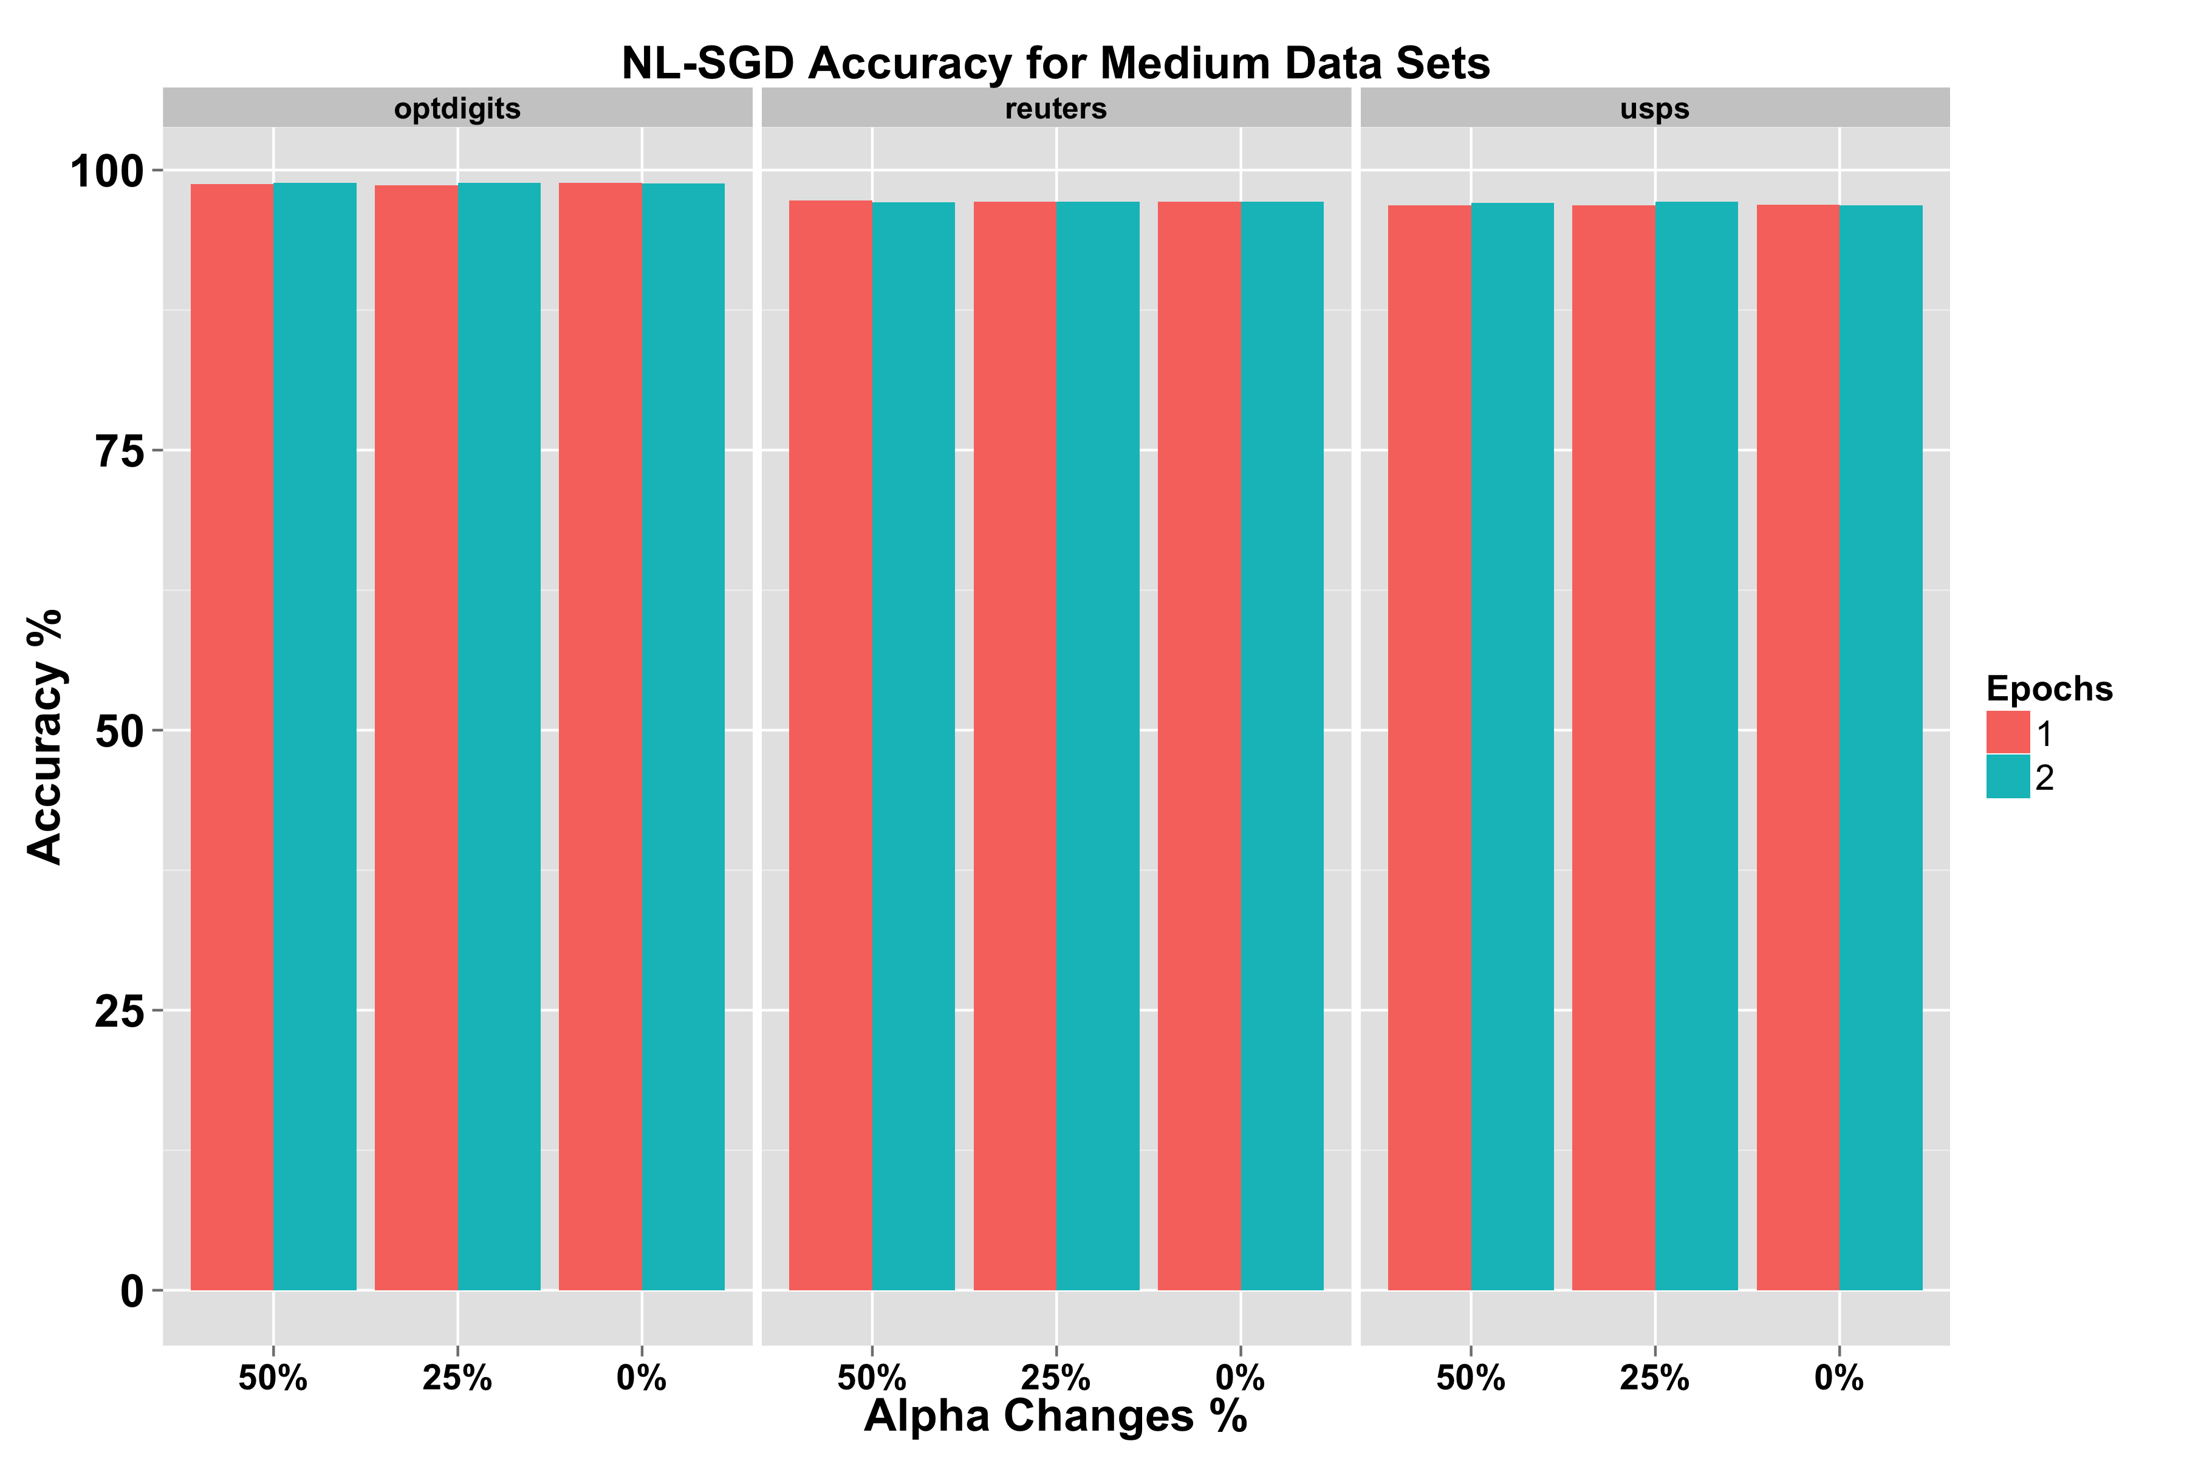
Results Accuracies Of The Different Configurations of NL-SGD
Small Datasets
For smaller sized datasets (Wine, Glass, Teach), the accuracy achieved with 5 epochs surpasses that with 2
For larger of the small datasets (Prokaryotic, Eukaryotic), the accuracy with 2 epochs is better
50% and 25% alpha updates are generally better than taking the last alpha update
Medium Datasets
There are minimal differences in the accuracies for using 1 or 2 epochs
Taking the last 25% of alpha updates show to be slightly better on the medium datasets shown

Slide 13
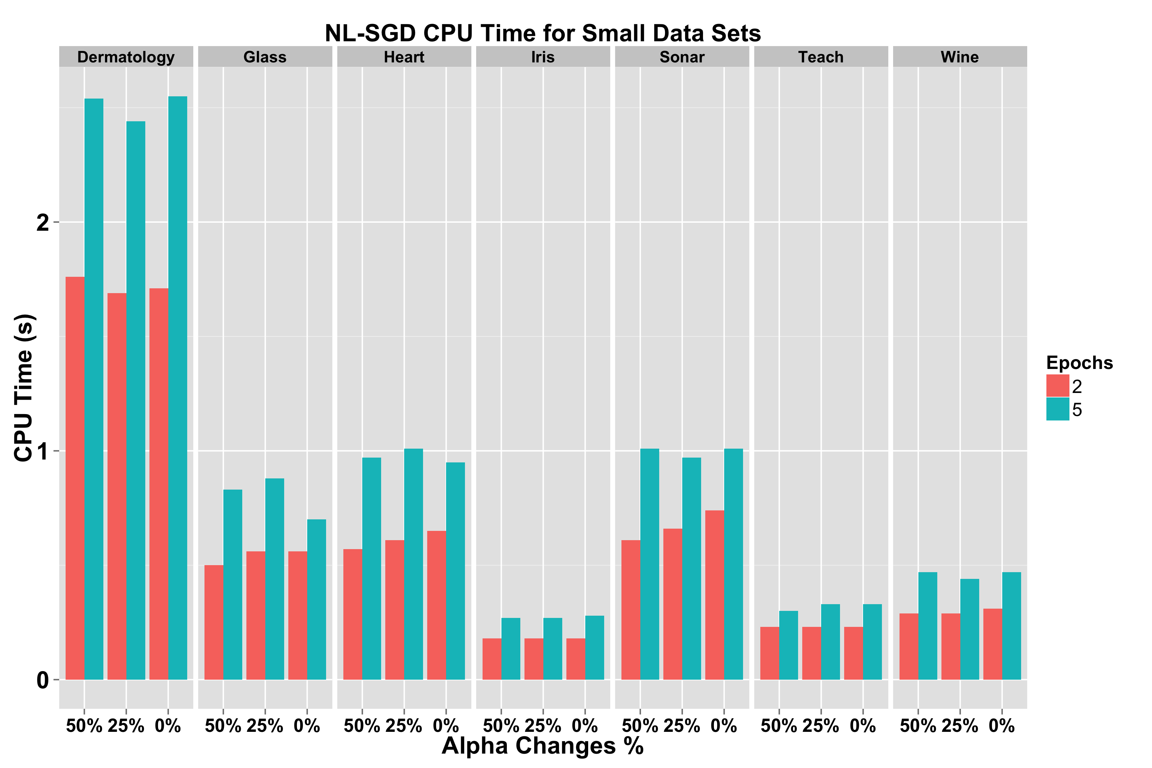
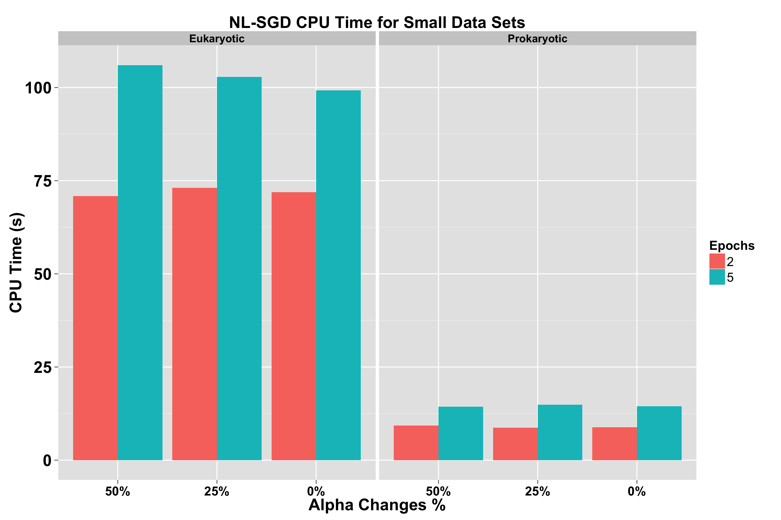
Results CPU Training Times Of The Different Configurations of NL-SGD on Small Datasets
For Small and Medium Datasets
Trade-off with balancing the number of epochs to achieve higher accuracy, while maintaining fast CPU training time
As the number of samples increases, it is preferable to use a lower epoch number

Slide 14
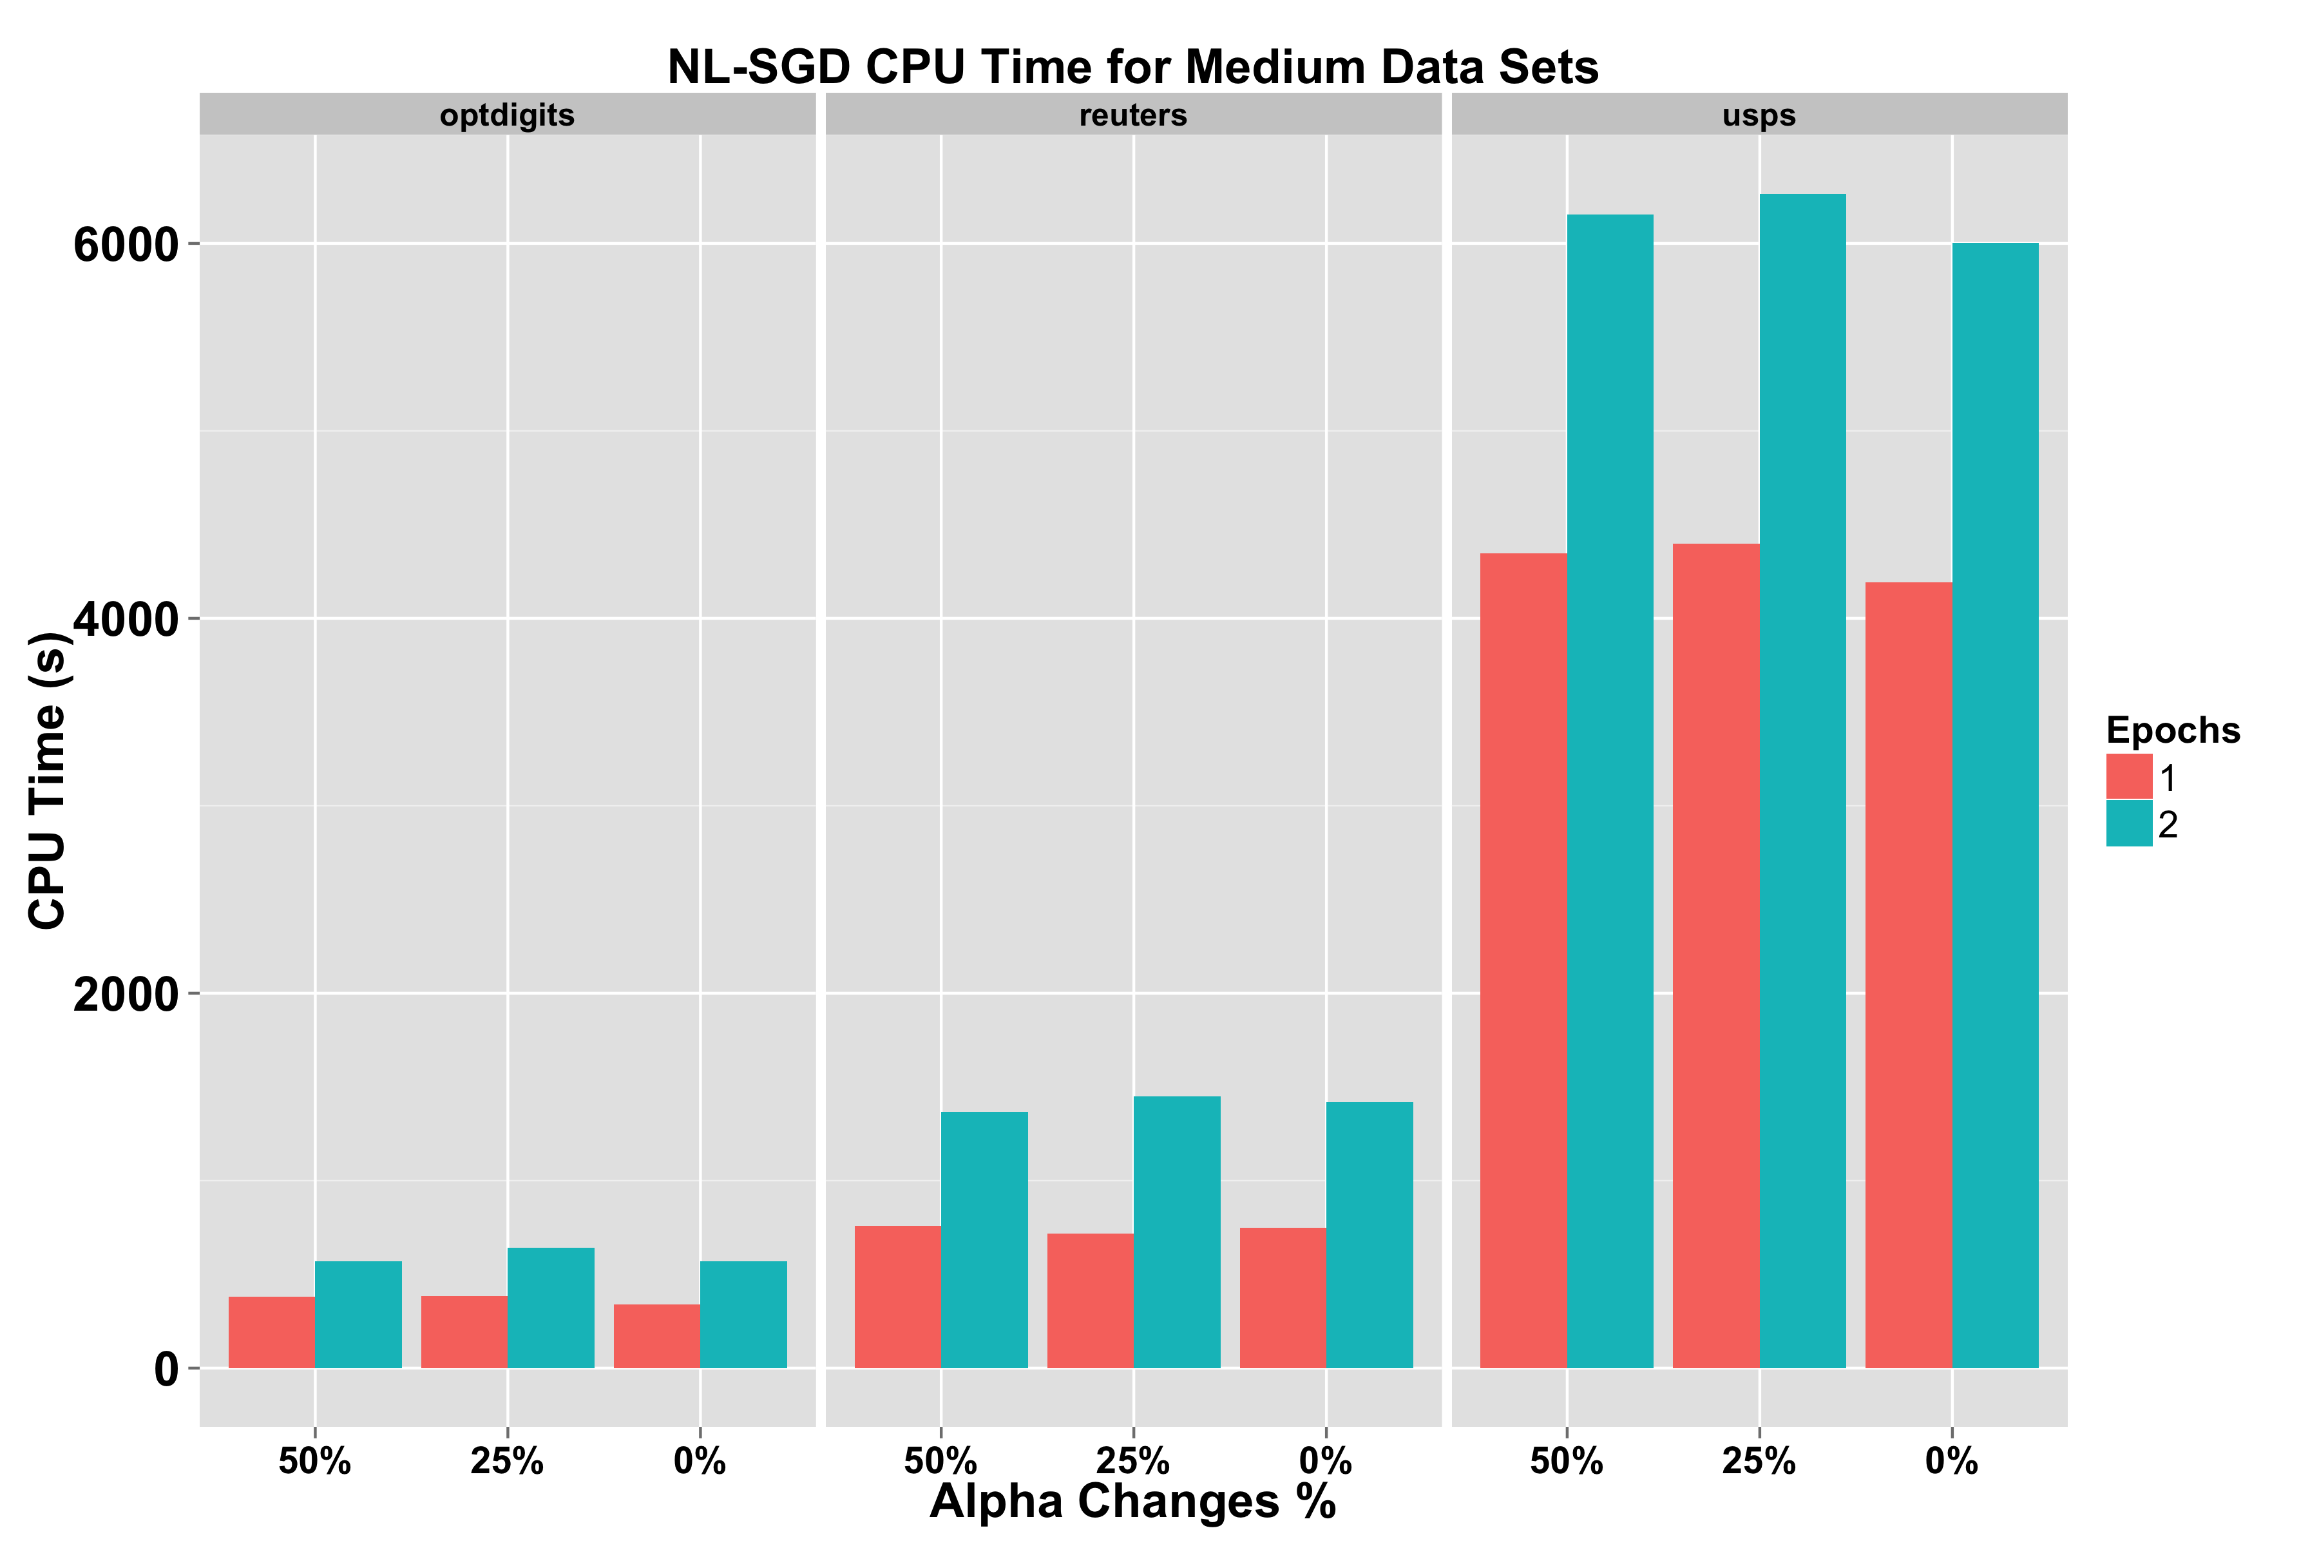
Results CPU Training Times Of The Different Configurations of NL-SGD on Medium Datasets
Accuracy and CPU Training Times on Medium Datasets
In order to show the balance between using a higher number of epochs, and how that affects the Accuracy and the CPU Training time, the results for both metrics are shown on the medium datasets
The performance is similar when using different alpha averaging percentages in the context of CPU Training Time, but in terms of Accuracy, 25% performs better

Slide 15
Conclusion
Potential for fast learning and building accurate models using stochastic algorithms is very promising
NL-SGD shows CPU time speed-up with respect to the fastest (known to us) SVM algorithms
The fact that online methods’ training times are independent of the SVM penalty parameter C, unlike traditional methods such as Sequential Minimal Optimization, gives them a competitive edge

